Slide 1
NoSQL Theory, Implementations, an introduction

Slide 2
NoSQL
What does it mean?
Not Only SQL.

Slide 3
Use Cases
Massive write performance.
Fast key value look ups.
Flexible schema and data types.
No single point of failure.
Fast prototyping and development.
Out of the box scalability.
Easy maintenance.

Slide 4
Motives Behind NoSQL
Big data.
Scalability.
Data format.
Manageability.

Slide 5
Big Data
Collect.
Store.
Organize.
Analyze.
Share.
Data growth outruns the ability to manage it so we need scalable solutions.

Slide 6
Scalability
Scale up, Vertical scalability.
Increasing server capacity.
Adding more CPU, RAM.
Managing is hard.
Possible down times

Slide 7
Scalability
Scale out, Horizontal scalability.
Adding servers to existing system with little effort, aka Elastically scalable.
Bugs, hardware errors, things fail all the time.
It should become cheaper. Cost efficiency.
Shared nothing.
Use of commodity/cheap hardware.
Heterogeneous systems.
Controlled Concurrency (avoid locks).
Service Oriented Architecture. Local states.
Decentralized to reduce bottlenecks.
Avoid Single point of failures.
Asynchrony.
Symmetry, you don’t have to know what is happening. All nodes should be symmetric.

Slide 8
What is Wrong With RDBMS?
Nothing. One size fits all? Not really.
Impedance mismatch.
Object Relational Mapping doesn't work quite well.
Rigid schema design.
Harder to scale.
Replication.
Joins across multiple nodes? Hard.
How does RDMS handle data growth? Hard.
Need for a DBA.
Many programmers are already familiar with it.
Transactions and ACID make development easy.
Lots of tools to use.

Slide 9
ACID Semantics
Atomicity: All or nothing.
Consistency: Consistent state of data and transactions.
Isolation: Transactions are isolated from each other.
Durability: When the transaction is committed, state will be durable.
Any data store can achieve Atomicity, Isolation and Durability but do you always need consistency? No.
By giving up ACID properties, one can achieve higher performance and scalability.

Slide 10
Enter CAP Theorem
Also known as Brewer’s Theorem by Prof. Eric Brewer, published in 2000 at University of Berkeley.
“Of three properties of a shared data system: data consistency, system availability and tolerance to network partitions, only two can be achieved at any given moment.”
Proven by Nancy Lynch et al. MIT labs.

Slide 11
CAP Semantics
Consistency: Clients should read the same data. There are many levels of consistency.
Strict Consistency – RDBMS.
Tunable Consistency – Cassandra.
Eventual Consistency – Amazon Dynamo.
Availability: Data to be available.
Partial Tolerance: Data to be partitioned across network segments due to network failures.
Notes:
N : Number of nodes with a replica of data.
W: Number of nodes that must acknowledge the update.
R : Minimum number of nodes that succeeds read operation.
W + R > N Strong Consistency
W + R <= N Weak Consistency

Slide 12
A Simple Proof
Consistent and available
No partition.
App
Data
Data
A
B

Slide 13
A Simple Proof
Available and partitioned
Not consistent, we get back old data.
App
Data
Old Data
A
B

Slide 14
A Simple Proof
Consistent and partitioned
Not available, waiting…
App
New Data
Wait for new data
A
B

Slide 15
BASE, an ACID Alternative
Almost the opposite of ACID.
Basically available: Nodes in the a distributed environment can go down, but the whole system shouldn’t be affected.
Soft State (scalable): The state of the system and data changes over time.
Eventual Consistency: Given enough time, data will be consistent across the distributed system.

Slide 16
A Clash of cultures
ACID:
Strong consistency.
Less availability.
Pessimistic concurrency.
Complex.
BASE:
Availability is the most important thing. Willing to sacrifice for this (CAP).
Weaker consistency (Eventual).
Best effort.
Simple and fast.
Optimistic.

Slide 17
Distributed Transactions
Two phase commit.
Starbucks doesn’t use two phase commit by Gregor Hophe.
Possible failures
Network errors.
Node errors.
Database errors.
Problems:
Locking the entire cluster if one node is down
Possible to implement timeouts.
Possible to use Quorum.
Quorum: in a distributed environment, if there is
partition, then the nodes vote to commit or rollback.
Commit
Rollback
Coordinator
Acknowledge
Complete operation
Release locks

Slide 18
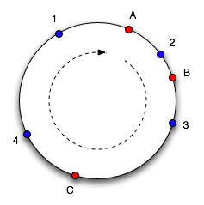
Consistent Hashing
Solves Partitioning Problem.
Consistent Hashing, Memcahced.
servers = [s1, s2, s3, s4, s5]
serverToSendData = servers[hash(data) % servers.length]
A New Hope
Continuum Approach.
Virtual Nodes in a cycle.
Hash both objects and caches.
Easy Replication.
Eventually Consistent.
What happens if nodes fail?
How do you add nodes?

Slide 19
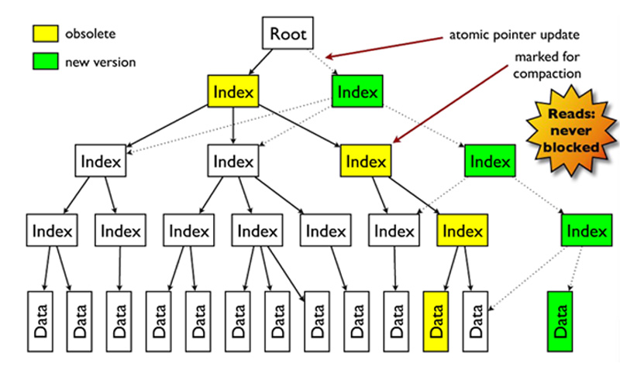
Concurrency models
Optimistic concurrency.
Pessimistic concurrency.
MVCC.

Slide 20
Vector Clocks
Used for conflict detection of data.
Timestamp based resolution of conflicts is not enough.
Time 1:
Time 2:
Replicated
Time 3:
Update
Time 4:
Update
Time 5:
Replicated
Conflict detection

Slide 21
Vector Clocks
A
Document.v.1([A, 1])
Update
A
Document.v.2([A, 2])
B
C
Document.v.2([A, 2],[B,1])
Document.v.2([A, 2],[C,1])
Conflicts are detected.

Slide 22
Read Repair
Value = Data.v2
Client
GET (K, Q=2)
Value = Data.v2
Update K = Data.v2
Value = Data.v1

Slide 23
Gossip Protocol & Hinted Handoffs
Most preferred communication protocol in a distributed environment is Gossip Protocol.
D
All the nodes talk to each other peer wise.
There is no global state.
No single point of coordinator.
If one node goes down and there is a Quorum
load for that node is shared among others.
Self managing system.
If a new node joins, load is also distributed.
A
G
H
B
Requests coming to F will be handled by
the nodes who takes the load of F, lets say C with
the hint that it took the requests which was for F,
when F becomes available, F will get this
Information from C. Self healing property.
C
F

Slide 24
Data Models
Key/Value Pairs.
Tuples (rows).
Documents.
Columns.
Objects.
Graphs.
There are corresponding data stores.

Slide 25
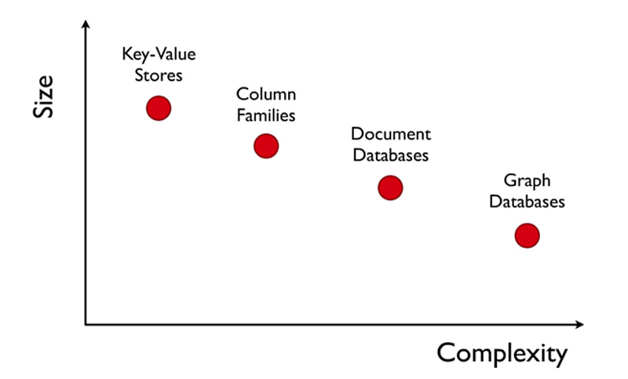
Complexity

Slide 26
Key-Value Stores
Memcached – Key value stores.
Membase – Memcached with persistence and improved consistent hashing.
AppFabric Cache – Multi region Cache.
Redis – Data structure server.
Riak – Based on Amazon’s Dynamo.
Project Voldemort – eventual consistent key value stores, auto scaling.

Slide 27
Memcached
Very easy to setup and use.
Consistent hashing.
Scales very well.
In memory caching, no persistence.
LRU eviction policy.
O(1) to set/get/delete.
Atomic operations set/get/delete.
No iterators, or very difficult.

Slide 28
Membase
Easy to manage via web console.
Monitoring and management via Web console .
Consistency and Availability.
Dynamic/Linear Scalability, add a node, hit join to cluster and rebalance.
Low latency, high throughput.
Compatible with current Memcached Clients.
Data Durability, persistent to disk asynchronously.
Rebalancing (Peer to peer replication).
Fail over (Master/Slave).
vBuckets are used for consistent hashing.
O(1) to set/get/delete.

Slide 29
Redis
Distributed Data structure server.
Consistent hashing at client.
Non-blocking I/O, single threaded.
Values are binary safe strings: byte strings.
String : Key/Value Pair, set/get. O(1) many string operations.
Lists: lpush, lpop, rpush, rpop.you can use it as stack or queue. O(1). Publisher/Subscriber is available.
Set: Collection of Unique elements, add, pop, union, intersection etc. set operations.
Sorted Set: Unique elements sorted by scores. O(logn). Supports range operations.
Hashes: Multiple Key/Value pairs
HMSET user 1 username foo password bar age 30
HGET user 1 age

Slide 30
Microsoft AppFabric
Add a node to the cluster easily. Elastic scalability.
Namespaces to organize different caches.
LRU Eviction policy.
Timeout/Time to live is default to 10 min.
No persistence.
O(1) to set/get/delete.
Optimistic and pessimistic concurrency.
Supports tagging.

Slide 31
Document Stores
Schema Free.
Usually JSON like interchange model.
Query Model: JavaScript or custom.
Aggregations: Map/Reduce.
Indexes are done via B-Trees.

Slide 32
Mongodb
Data types: bool, int, double, string, object(bson), oid, array, null, date.
Database and collections are created automatically.
Lots of Language Drivers.
Capped collections are fixed size collections, buffers, very fast, FIFO, good for logs. No indexes.
Object id are generated by client, 12 bytes packed data. 4 byte time, 3 byte machine, 2 byte pid, 3 byte counter.
Possible to refer other documents in different collections but more efficient to embed documents.
Replication is very easy to setup. You can read from slaves.

Slide 33
Mongodb
Connection pooling is done for you. Sweet.
Supports aggregation.
Map Reduce with JavaScript.
You have indexes, B-Trees. Ids are always indexed.
Updates are atomic. Low contention locks.
Querying mongo done with a document:
Lazy, returns a cursor.
Reduceable to SQL, select, insert, update limit, sort etc.
There is more: upsert (either inserts of updates)
Several operators:
$ne, $and, $or, $lt, $gt, $incr,$decr and so on.
Repository Pattern makes development very easy.

Slide 34
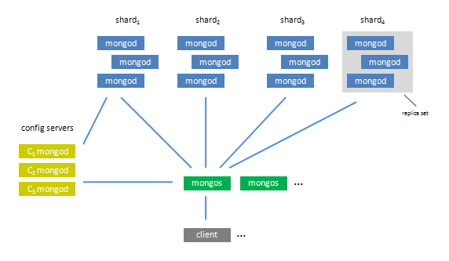
Mongodb - Sharding
Config servers: Keeps mapping
Mongos: Routing servers
Mongod: master-slave replicas

Slide 35
Couchdb
Availability and Partial Tolerance.
Views are used to query. Map/Reduce.
MVCC – Multiple Concurrent versions. No locks.
A little overhead with this approach due to garbage collection.
Conflict resolution.
Very simple, REST based. Schema Free.
Shared nothing, seamless peer based Bi-Directional replication.
Auto Compaction. Manual with Mongodb.
Uses B-Trees
Documents and indexes are kept in memory and flushed to disc periodically.
Documents have states, in case of a failure, recovery can continue from the state documents were left.
No built in auto-sharding, there are open source projects.
You can’t define your indexes.

Slide 36
Object Stores
Objectivity.
Db4o.

Slide 37
Objectivity
No need for ORM. Closer to OOP.
Complex data modeling.
Schema evolution.
Scalable Collections: List, Set, Map.
Object relations.
Bi-Directional relations
ACID properties.
Blazingly fast, uses paging.
Supports replication and clustering.

Slide 38
Column Stores
Row oriented
Id | username | email | Department
1 | John | john@foo.com | Sales
2 | Mary | mary@foo.com | Marketing
3 | Yoda | yoda@foo.com | IT
Column oriented
Id
1
2
3
Username
John
Mary
Yoda
email
john@foo.com
mary@foo.com
yoda@foo.com
Department
Sales
Marketing
IT

Slide 39
Cassandra
Tunable consistency.
Decentralized.
Writes are faster than reads.
No Single point of failure.
Incremental scalability.
Uses consistent hashing (logical partitioning) when clustered.
Hinted handoffs.
Peer to peer routing(ring).
Thrift API.
Multi data center support.

Slide 40
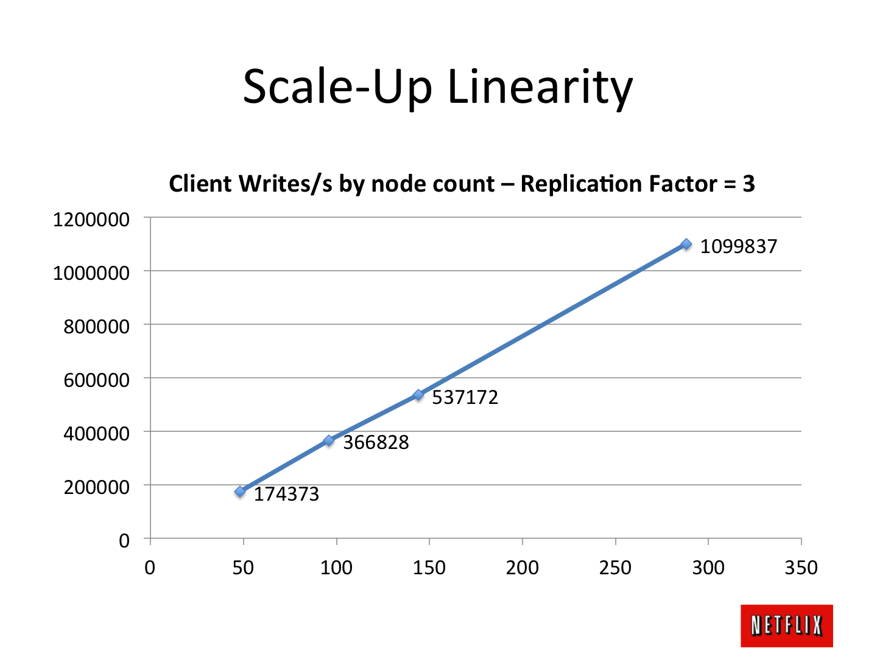
Cassandra at Netflix

Slide 41

Graph Stores
Based on Graph Theory.
Scale vertically, no clustering.
You can use graph algorithms easily.

Slide 42
Neo4J
Nodes, Relationship.
Traversals.
HTTP/REST.
ACID.
Web Admin.
Not too much support for languages.
Has transactions.

Slide 43
Which one to use?
Key-value stores:
Processing a constant stream of small reads and writes.
Document databases:
Natural data modeling. Programmer friendly. Rapid development. Web friendly, CRUD.
RDMBS:
OLTP. SQL. Transactions. Relations.
OODBMS
Complex object models.
Data Structure Server:
Quirky stuff.
Columnar:
Handles size well. Massive write loads. High availability. Multiple-data centers. MapReduce
Graph:
Graph algorithms and relations.

Slide 44
SQL vs NoSQL

Slide 45
In The Beginning
Programmers processed files directly
You would open a file, seek and read its contents, and parse out a record (same for insert / update / delete)
Obviously, a lot of similar code was written, and eventually refactored into libraries
These libraries became databases, each with their own strengths and weaknesses, and their own APIs
IBM came up with the idea for SEQUEL (Structured English QUEry Language) around 1970, and was implemented in several database libraries

Slide 46
RDBMS
Relational DataBase Management System
Main Focus is ACID
Atomicity – Each transaction is atomic. If one part of it fails, the entire transaction fails (and is rolled back)
Consistency – Every transaction is subject to a consistent set of rules (constraints, triggers, cascades)
Isolation – No transaction should interfere with another transaction
Durability – Once a transaction is committed, it remains committed

Slide 47
RDBMS
ACID is important
But only when it’s important
i.e. banking, finance, safety systems, etc.
The kinds of systems that people were building with computers 30 years ago (and today)
ACID adds overhead
Features like atomicity, isolation basically force database servers to use sequential evaluation
Add a concept like multiple-servers?

Slide 48
RDBMS
Other Features
Typed columns
Normalized data
Supports broad, unrestrained queries
Has its own query optimizer
Consistent way of accessing data (SQL)

Slide 49
SQL
A common (for the most part) query language for RDBMS
Enables unrestrained queries against normalized data
Geared towards joins, filters, and aggregations
Relies heavily on the database server’s query optimization
Sometimes requires the involvement of a DBA

Slide 50
The CAP Theorem
Impossible for any shared data-system to guarantee simultaneously all of the following three properties:
Consistency – once data is written, all future read requests will contain that data
Availability – the database is always available and responsive
Partition Tolerance – if part of the database is unavailable, other parts are unaffected

Slide 51
Good Quote!
Google, Amazon, Facebook, and DARPA all recognized that when you scale systems large enough, you can never put enough iron in one place to get the job done (and you wouldn’t want to, to prevent a single point of failure). Once you accept that you have a distributed system, you need to give up consistency or availability, which the fundamental transactionality of traditional RDBMSs cannot abide.
- Cedric Beust

Slide 52
Enter NoSQL
RDBMS doesn’t quite fit for *some* requirements
Google and Amazon decided to make their own stuff (aka BigTable and S3 Storage) to meet their own unique needs
Distributed
Scalability
Control over performance characteristics
High availability
Low Latency
Cheap

Slide 53
What is NoSQL?
Basically a large serialized object store*
(mostly) retrieve objects by defined ID
In general, doesn’t support complicated queries*
Doesn’t have a structured (or any!) schema*
Recommends denormalization
Designed to be distributed (cloud-scale) out of the box
Because of this, drops the ACID requirements
Any database can answer any query
Any write query can operate against any database and will “eventually” propagate to other distributed servers
* Dependent on vendor

Slide 54
The opposite of ACID is…
BASE
Basically Available – guaranteed availability
Soft-state – the state of the system may change, even without a query (because of node updates)
Eventually Consistent – the system will become consistent over time
Contrived acronym, but so is ACID :P

Slide 55
NoSQL – Eventual Consistency
Because of the distributed model, any server can answer any query
Servers communicate amongst themselves at their own pace (behind the scenes)
The server that answers your query might not have the latest data
Who really cares if you see Kim Kardashian’s latest tweet instantaneously?

Slide 56
Different Types of NoSQL
Column Store
Column data is saved together, as opposed to row data
Super useful for data analytics
Hadoop, Cassandra, Hypertable
Key-Value Store
A key that refers to a payload
MemcacheDB, Azure Table Storage, Redis
Document / XML / Object Store
Key (and possibly other indexes) point at a serialized object
DB can operate against values in document
MongoDB, CouchDB, RavenDB
Graph Store
Nodes are stored independently, and the relationship between nodes (edges) are stored with data

Slide 57
Also Important – MapReduce
One of the most common large queries (and hard to optimize) is Map Reduce
Map: Select a subset of data (into a key, value pair)
Reduce: Perform some sort of operation on that data
Used primarily for data analysis (reporting)
Example: Average revenue on all invoices in 2010
In RDBMS, this is usually pretty expensive
Involves a full table scan with a select
If it’s not a built-in aggregate function, involves custom code on database server (sproc/udf)
In (some) NoSQL, it’s automagically distributed
MapReduce functions are automatically distributed across all nodes to process, and the result is automatically gathered and returned as part of the vendor’s framework
In Google’s environment, can run a MapReduce operation across all their nodes in about 30 minutes.

Slide 58
NoSQL, Mo’ Problems
Inconsistent APIs between NoSQL providers
Denormalized data requires you to maintain your own data relationships (cascades) in code
Not a lot of real operational power for DevOps / IT
Lack of complicated queries requires joins / aggregations / filters to be done in code (except for MapReduce)
Arguably not a bad thing?

Slide 59
That being said…
NoSQL-type databases power:
Google reader
Google maps
Blogger.com
Youtube
Gmail
Amazon
Sourceforge
Github
CollegeHumor
Justin.tv
Grooveshark
BMW
Cisco
Honda
Mozilla
Adobe
Ebay
Facebook
Hulu
Last.Fm
LinkedIn
New York Times
Twitter
Yahoo!
Disney
Craigslist
Foursquare
Forbes
Bit.ly
Intuit
Boeing
US Army
Seagate
Hertz
IBM
Intel
Oxford University Press
United Airways
University of Toronto
XQ ☺

Slide 60
In Conclusion!
RDBMS is a great tool for solving ACID problems
When data validity is super important
When you need to support dynamic queries
NoSQL is a great tool for solving data availability problems
When it’s more important to have fast data than right data
When you need to scale based on changing requirements
Pick the right tool for the job

Slide 61
Column Based Database

Slide 62
Columnar Databases Overview
A column-oriented DBMS is a database management system (DBMS) that stores its content by column rather than by row. This has advantages for data warehouses and library catalogues where aggregates are computed over large numbers of similar data items.
A column-oriented database serializes all of the values of a column together, then the values of the next column, and so on. In a column-oriented database, only the columns in the query need to be retrieved.
Advantage of column oriented databases over row oriented databases is in the efficiency of hard-disk access.

Slide 63
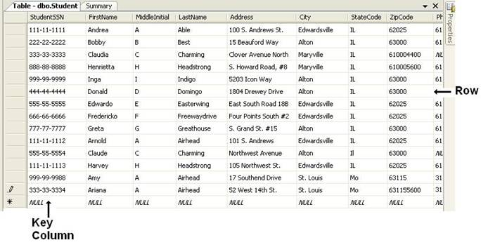
Disadvantage of a Row Based Database
In a RDBMS, data values are collected and managed as individual rows and events containing related rows.
A row-oriented database must read the entire record or “row” in order to access the needed attributes or column data.
Queries most often end up reading significantly more data than is needed to satisfy the request and it creates very large I/O burdens.
Architects and DBAs often tune the environment for the different queries by building additional indexes, pre-aggregating data, and creating special materialized views and cubes. Resulted in more processing time and consume additional persistent data storage.
Most of the tuning are query-specific, these tunings only address the performance of the queries that are known, and do not even touch upon general performance of ad hoc queries.

Slide 64
One difference that Matters Most
The major significant difference between columnar and row-based stores is that all the columns of a table are not stored successively in storage – in the data pages. This eliminates much of the metadata that is stored on a data page, which helps the data management component of the DBMS navigate the many columns in a row-based database as quickly as it can. In a relational, row-based page, there is a map of offsets near the end of the page to where the records start on the page. This map is updated as records come and go on the page. The offset number is also an important part of how an index entry would find the rest of the record in the data page in a row-based system. The need for indexes is greatly minimized in column-based systems, to the point of not being offered in many columnar Databases.

Slide 65
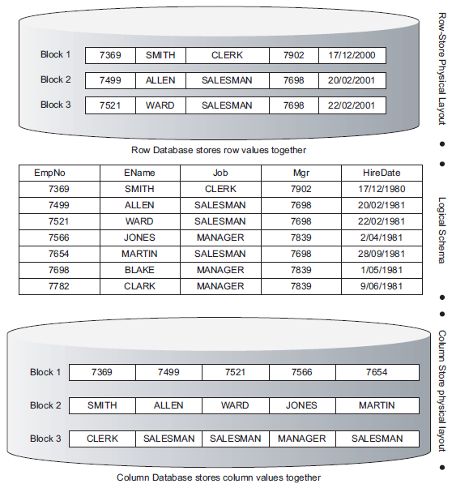
Columnar Database
A column-oriented database has its data organized and stored by columns.
System can evaluate which columns are being accessed and retrieve only the values requested from the specific columns.
The data values themselves within each column form the index, reducing I/O, enabling rapid access.

Slide 66
Food for Thought !!!!
Think about it from an efficiency standpoint. When I want just a few songs from an album, it’s cheaper to purchase only those songs from iTunes that I want. When I want most of the songs, I will save a couple bucks by purchasing the whole album. Over time, I may find that I like one of those songs. However, when it comes to a query, the query either wants a column or it doesn’t. It will not come to like a column later that it was forced to select. This is foundational to the value proposition for columnar databases…..

Slide 67
Benefits of a Columnar Database
Better analytic performance: row oriented approach allows better performance in running a large number of simultaneous queries.
Rapid joins and aggregation: data access streaming along column-oriented data allows for incrementally computing the results of aggregate functions, which is critical for data warehouse applications.
Suitability for compression: Eliminates storage of multiple indexes, views and aggregations, and facilitates vast improvements in compression.
Rapid data loading: In a columnar arrangement the system effectively allows one to segregate storage by column. This means that each column is built in one pass, and stored separately, allowing the database system to load columns in parallel using multiple threads. Further, related performance characteristics of join processing built atop a column store is often sufficiently fast that the load-time joining required to create fact tables is unnecessary, shortening the latency from receipt of new data to availability for query processing. Finally, since columns are stored separately, entire table columns can be added and dropped without downing the system, and without the need to re-tuning the system following the change
Notes:
Rapid joins and aggregation: data access streaming along column-oriented data allows for incrementally computing the results of aggregate functions, which is critical for data warehouse applications. In addition, there is no requirement for different columns of data to be stored together; allocating columnar data across multiple processing units and storage allows for parallel accesses and aggregations as well, increasing the overall query performance.
Suitability for compression: The columnar storage of data not only eliminates storage of multiple indexes, views and aggregations, but also facilitates vast improvements in compression, which can result in an additional reduction in storage while maintaining high performance.
Rapid data loading: The typical process for loading data into a data warehouse involves extracting data into a staging area, performing transformations, joining data to create demoralized representations and loading the data into the warehouse as fact and dimension tables, and then creating the collection of required indexes and views. In a row-based arrangement, all of the data values in each row need to be stored together, and then indexes must be constructed by reviewing all the row data. In a columnar arrangement the system effectively allows one to segregate storage by column. This means that each column is built in one pass, and stored separately, allowing the database system to load columns in parallel using multiple threads. Further, related performance characteristics of join processing built atop a column store is often sufficiently fast that the load-time joining required to create fact tables is unnecessary, shortening the latency from receipt of new data to availability for query processing. Finally, since columns are stored separately, entire table columns can be added and dropped without downing the system, and without the need to re-tuning the system following the change

Slide 68
Challenges
No one-size-fits-all system.
Load time: Converting the data source into columnar format can be unbearably slow where tens or hundreds of gigabytes of data are involved.
Incremental loads: Incremental loads can be performance problematic.
Data compression: Some columnar systems greatly compress the source data. However, uncompressing the data to read it can slow performance.
Structural limitations: Columnar databases use different techniques to simulate a relational structure. Some require the same primary key on all tables, meaning the database hierarchy is limited to two levels. The limits imposed by a particular system may not seem to matter, but remember that your needs may change tomorrow. Constraints that seem acceptable now could prevent you from expanding the system in the future.
Scalability: Columnar databases major advantage is to get good performance on large databases. However, is there is reasonable to use columnar databases in case you are dealing with common size database?
Notes:
Load time, incremental loads, and data compression. These all reflect the need for a columnar database to restructure data originally stored in another format. They can be critical bottlenecks at large data volumes, and older systems varied widely in their performance. As a result, these were probably the most important considerations when comparing older columnar systems.

Slide 69
Best Practices in using Columnar DB
Use to Save Money on Storage
All column data stores keep the data in the same row order so that when the records are pieced together, the correct concatenation of columns is done to make up the row.
matches values to rows according to the position of the value (i.e., 3rd value in each column belongs to the 3rd row, etc.). This way “SUVRADEEP” (from the first name column file2) is matched with “RUDRA” (from the last name column file) correctly – instead of matching “DAS” with “SUVRADEEP”, for example.
Dictionary Method - dictionary structure is used to store the actual values along with tokens .
The dictionary arrangement allows DB, to trim insignificant trailing nulls from character fields, furthering the space savings. Effectively, characters over 8 bytes are treated as variable length characters.

Slide 70
For example, 1=State Grid Corporation of China, 2=Nippon Telegraph and Telephone and 3=Federal Home Loan Mortgage Corporation could be in the dictionary and when those are the column values, the 1, 2 and 3 are used in lieu of the actual values. If there are 1,000,000 customers with only 50 possible values, the entire column could be stored with 8 megabytes (8 bytes per value). The separate dictionary structure, containing each unique value and its associated token, would have more page-level metadata. Since each value can have a different length, a map to where the values start on the page would be stored, managed and utilized in page navigation.
DICTIONARY: 1, State Grid Corporation of China, 2, Nippon Telegraph and Telephone, 3, Federal Home Loan Mortgage Corporation
DATA PAGE: 1,3,2,3,1,3,1, …

Slide 71
Speed for Input/output Bound Queries
Optimized the I/O operation
In row-based databases, complete file scans mean I/O of data that is non-essential to the query. This non-essential data could comprise a very large percentage of the I/O.
Much more of the data in the I/O is essential to a columnar query. An I/O in a columnar database will only retrieve one column – a column interesting to the particular query from either a selection or projection (WHERE clause) capacity. The projection function starts first and gathers a list of record numbers to be returned, which is used with the selection queries (if different from projection) to materialize the result set.
Columnar databases can perform full column scans much quicker than a row-based system would turn to a full table scan. Query time spent in the optimizer is reduced significantly.
Columnar databases are one of many new approaches taking workloads off the star schema data warehouse, which is where many of the I/O bound queries are today. Heterogeneity in post-operational systems is going to be the norm for some time, and columnar databases are a major reason because they can outperform many of the queries executed in the data warehouse.

Slide 72
Beyond Cubes
Multidimensional databases (MDBs), or cubes, are separate physical structures that support very fast access to selective data.
When a query asks for most columns of the MDB, the MDB will perform quite well. The physical storage of these MDBs is a demoralized dimensional model, which eliminates joins. However, MDBs get large and grow faster than expected as columns are added. They can also grow in numbers across the organization, becoming an unintentional impediment to information access.
The processing step (data load) can be quite lengthy, especially on large data volumes in a MDB.
Difficulty updating and querying models with more than ten dimensions.
Traditionally have difficulty querying models with dimensions with very high cardinality
It is difficult to develop the necessary discipline to use MDBs with its best-fit workloads. MDB abuse is a major cause of the complete overhaul of the information management environment. Many are looking for scalable alternatives and the analytic workloads used with MDBs tend to have a lot in common with the more manageable columnar databases.

Slide 73
Not a cup of tea for Hadoop
Hadoop is a parallel programming framework for large-scale data.
The ideal workload for Hadoop is data that is massive not only from the standpoint of collecting history over time, but also from the standpoint of high volume in a single day.
Hadoop systems are flat file based with no relational database for performance, nearly all queries run a file scan for every task, even if the answer is found in the first block of disk data.
Hadoop systems are best suited for unstructured data, for that is the data that amasses large very quickly, needing only batch processing and a basic set of query capabilities.
It is not for data warehousing nor the analytic, warehousing-like workloads.
Therefore ,summary data will be sent from Hadoop (using Sqoop ,Flume, Hive ..etc) to the columnar database. Analysts and business consumers access the columnar database 7 X 24 for ad-hoc reporting and analysis, whereas Hadoop access is scheduled and more restricted.
Columnar databases allow you to implement a data model free of the tuning and massaging that must occur to designs in row-based databases, such as making the tables unnaturally small to simulate columnar efficiencies.
*Sqoop - Integration of databases and data warehouses with Hadoop
*Flume - Configurable streaming data collection
*Hive - SQL-like queries and tables on large datasets

Slide 74
Conclusion
Columnar database benefits are enhanced with larger amounts of data, large scans and I/O bound queries. While providing performance benefits, they also have unique abilities to compress their data, like cubes, data warehouses and Hadoop, they are an important component of a modern, heterogeneous environment. By following these guidelines and moving the best workloads to columnar databases ,an organization is best enabled to pursue the full utilization of one of its most important assets - information.

Slide 75
MongoDB
Introduction to

Slide 76
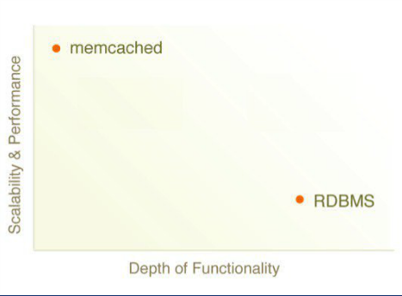
The Great Divide
MongoDB - Sweet Spot: Easy, Flexible and Scalable

Slide 77
What is MongoDB ?
• Scalable High-Performance Open-source, Document-orientated database.
• Built for Speed
• Rich Document based queries for Easy readability.
• Full Index Support for High Performance.
• Replication and Failover for High Availability.
• Auto Sharding for Easy Scalability.
• Map / Reduce for Aggregation.

Slide 78
Why use MongoDB?
• SQL was invented in the 70’s to store data.
• MongoDB stores documents (or) objects.
• Now-a-days, everyone works with objects (Python/Ruby/Java/etc.)
• And we need Databases to persist our objects. Then why not store objects directly ?
• Embedded documents and arrays reduce need for joins. No Joins and No-multi document transactions.

Slide 79
What is MongoDB great for?
• RDBMS replacement for Web Applications.
• Semi-structured Content Management.
• Real-time Analytics & High-Speed Logging.
• Caching and High Scalability
Web 2.0, Media, SAAS, Gaming
HealthCare, Finance, Telecom, Government

Slide 80









Not great for?
• Highly Transactional Applications.
• Problems requiring SQL.
Some Companies using MongoDB in Production

Slide 81
Let’s Dive in !

Slide 82
Database
When I say
Think
Database
• Made up of Multiple Collections.
• Created on-the-fly when referenced for the first time.

Slide 83
Collection
When I say
Think
Table
• Schema-less, and contains Documents.
• Indexable by one/more keys.
• Created on-the-fly when referenced for the first time.
• Capped Collections: Fixed size, older records get dropped after reaching the limit.

Slide 84
Document
When I say
Think
Record/Row
• Stored in a Collection.
• Can have _id key – works like Primary keys in MySQL.
• Supported Relationships – Embedded (or) References.
• Document storage in BSON (Binary form of JSON).

Slide 85
Understanding the Document Model.
var p = {
‘_id’: ‘3432’,
‘author’: DBRef(‘User’, 2),
‘title’: ‘Introduction to MongoDB’,
‘body’: ‘MongoDB is an open sources.. ‘,
‘timestamp’: Date(’01-04-12’),
‘tags’: [‘MongoDB’, ‘NoSQL’],
‘comments’: [{‘author’: DBRef(‘User’, 4),
‘date’: Date(’02-04-12’),
‘text’: ‘Did you see.. ‘,
‘upvotes’: 7, … ]
}
> db.posts.save(p);

Slide 86
Secondary Indexes
Create Index on any field in the document
// 1 means ascending, -1 means descending
> db.posts.ensureIndex({‘author’: 1});
//Index Nested Documents
> db.posts.ensureIndex(‘comments.author’: 1);
// Index on tags
> db.posts.ensureIndex({‘tags’: 1});
// Geo-spatial Index
> db.posts.ensureIndex({‘author.location’: ‘2d’});

Slide 87
What about Queries? So Simple
// find posts which has ‘MongoDB’ tag.
> db.posts.find({tags: ‘MongoDB’});
// find posts by author’s comments.
> db.posts.find({‘comments.author’: DBRef(‘User’,2)}).count();
// find posts written after 31st March.
> db.posts.find({‘timestamp’: {‘gte’: Date(’31-03-12’)}});
// find posts written by authors around [22, 42]
> db.posts.find({‘author.location’: {‘near’:[22, 42]});
$gt, $lt, $gte, $lte, $ne, $all, $in, $nin, count, limit, skip, group, etc…

Slide 88
What about Updates? Atomic Operations makes it simple
db.posts.update({_id: ‘3432’},
{‘title’: ‘Introduction to MongoDB (updated)’,
‘text’: ‘Updated text’,
${addToSet: {‘tags’: ‘webinar’}});
$set, $unset
$push, $pull, $pop, $addToSet
$inc, $decr, many more…
Where are my joins and transactions? !!!

Slide 89
Some Cool features
• Geo-spatial Indexes for Geo-spatial queries.
$near, $within_distance, Bound queries (circle, box)
• GridFS
Stores Large Binary Files.
• Map/Reduce
GROUP BY in SQL, map/reduce in MongoDB.

Slide 90
Deployment & Scaling

Slide 91
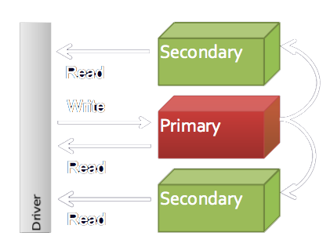
Replica Sets

Slide 92
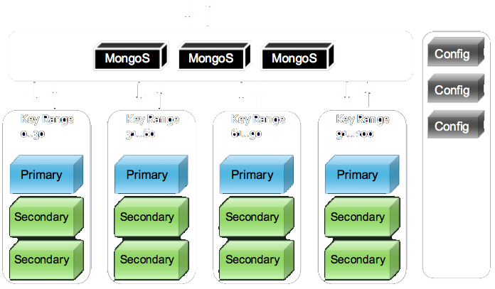
Sharding

Slide 93
MongoDB Indexing and Query Optimizer Details

Slide 94
Btree (just a conceptual diagram)
5
2
7
1
3
4
6
8
9
{_id:4,x:6}

Slide 95
Basic Index Bounds

Slide 96
Find One Document
db.c.find( {x:6} ).limit( 1 )
Index {x:1}

Slide 97
Find One Document
6
?
1
2
3
4
5
6
7
8
9
{_id:4,x:6}

Slide 98
Find One Document
"nscanned" : 1,
"nscannedObjects" : 1,
"n" : 1,

Slide 99
Find One Document
6
?
5
2
7
1
3
4
6
8
9
{_id:4,x:6}

Slide 100
Find One Document
6
?
5
2
7
1
3
4
6
8
9
{_id:4,x:6}

Slide 101
Find One Document
6
?
Now we have duplicate x values
1
2
3
4
5
6
6
6
9
{_id:4,x:6}

Slide 102
Find One Document
6
?
5
2
6
1
3
4
6
6
9
{_id:4,x:6}

Slide 103
Equality Match
db.c.find( {x:6} )
Index {x:1}

Slide 104
Equality Match
6
?
1
2
3
4
5
6
6
6
9
{_id:4,x:6}
{_id:5,x:6}
{_id:1,x:6}

Slide 105
Equality Match
6
?
5
2
6
1
3
4
6
6
9

Slide 106
Full Document Matcher
db.c.find( {x:6,y:1} )
Index {x:1}

Slide 107
Full Document Matcher
6
?
1
2
3
4
5
6
6
6
9
{y:4,x:6}
{y:5,x:6}
{y:1,x:6}

Slide 108
Full Document Matcher
"nscanned" : 3,
"nscannedObjects" : 3,
"n" : 1,
Documents for all matching keys scanned, but only one document matched on non index keys.

Slide 109
Range Match
db.c.find( {x:{$gte:4,$lte:7}} )
Index {x:1}

Slide 110
Range Match
4
<= ? <=
7
1
2
3
4
5
6
7
8
9

Slide 111
Range Match
"nscanned" : 4,
"nscannedObjects" : 4,
"n" : 4,

Slide 112
Range Match
5
2
7
1
3
4
6
8
9

Slide 113
Exclusive Range Match
db.c.find( {x:{$gt:4,$lt:7}} )
Index {x:1}

Slide 114
Exclusive Range Match
4
< ? <
7
1
2
3
4
5
6
7
8
9

Slide 115
Exclusive Range Match
"indexBounds" : {
"x" : [
[
4,
7
]
]
}
Explain doesn’t indicate that the range is exclusive.

Slide 116
Exclusive Range Match
"nscanned" : 2,
"nscannedObjects" : 2,
"n" : 2,
But index keys matching the range bounds are not scanned because the bounds are exclusive.

Slide 117
Exclusive Range Match
5
2
7
1
3
4
6
8
9

Slide 118
Multikeys
db.c.find( {x:{$gt:7}} )
Index {x:1}

Slide 119
Multikeys
? >
7
1
2
3
4
5
6
7
8
9
{_id:4,x:[8,9]}

Slide 120
Multikeys
"nscanned" : 2,
"nscannedObjects" : 2,
"n" : 1,
All keys in valid range are scanned, but the matcher rejects duplicate documents making n == 1.

Slide 121
Multikeys
5
2
7
1
3
4
6
8
9

Slide 122
Set Match
db.c.find( {x:{$in:[3,6]}} )
Index {x:1}

Slide 123
Set Match
3
,
6
1
2
3
4
5
6
7
8
9

Slide 124
Set Match
"nscanned" : 3,
"nscannedObjects" : 2,
"n" : 2,
Why is nscanned 3? This is an algorithmic detail we’ll discuss more later, but when there are disjoint ranges for a key nscanned may be higher than the number of matching keys.

Slide 125
Set Match
5
2
7
1
3
4
6
8
9

Slide 126
All Match
db.c.find( {x:{$all:[3,6]}} )
Index {x:1}

Slide 127
All Match
3
?
1
2
3
4
5
6
7
8
9
{_id:4,x:[3,6]}

Slide 128
All Match
"indexBounds" : {
"x" : [
[
3,
3
]
]
}
The first entry in the $all match array is always used for index bounds. Note this may not be the least numerous indexed value in the $all array.

Slide 129
All Match
"nscanned" : 1,
"nscannedObjects" : 1,
"n" : 1,

Slide 130
All Match
5
2
7
1
3
4
6
8
9

Slide 131
Limit
db.c.find( {x:{$lt:6},y:3} ).limit( 3 )
Index {x:1}

Slide 132
Limit
? <
6
1
2
3
4
5
6
7
8
9
y:3
y:3
y:3
y:1
y:3

Slide 133
Limit
"nscanned" : 4,
"nscannedObjects" : 4,
"n" : 3,
Scan until three matches are found, then stop.

Slide 134
Skip
db.c.find( {x:{$lt:6},y:3} ).skip( 3 )
Index {x:1}

Slide 135
Skip
? <
6
1
2
3
4
5
6
7
8
9
y:3
y:3
y:3
y:1
y:3

Slide 136
Skip
"nscanned" : 5,
"nscannedObjects" : 5,
"n" : 1,
All skipped documents are scanned.

Slide 137
Sort
db.c.find( {x:{$lt:6}} ).sort( {x:1} )
Index {x:1}

Slide 138
Sort
? <
6
1
2
3
4
5
6
7
8
9
y:3
y:3
y:3
y:1
y:3

Slide 139
Sort
"cursor" : "BtreeCursor x_1",

Slide 140
Sort
db.c.find( {x:{$lt:6}} ).sort( {y:1} )
Index {x:1}

Slide 141
Sort
? <
6
1
2
3
4
5
6
7
8
9
y:3
y:3
y:3
y:1
y:3

Slide 142
Sort
"cursor" : "BtreeCursor x_1",
"nscanned" : 5,
"nscannedObjects" : 5,
"n" : 4,
"scanAndOrder" : true,
Results are sorted on the fly to match requested order. The scanAndOrder field is only printed when its value is true.

Slide 143
Sort and scanAndOrder
With “scanAndOrder” sort, all documents must be touched even if there is a limit spec.
With scanAndOrder, sorting is performed in memory and the memory footprint is constrained by the limit spec if present.

Slide 144
Count
db.c.count( {x:{$gte:4,$lte:7}} )
Index {x:1}

Slide 145
Count
4
<= ? <=
7
1
2
3
4
5
6
7
8
9

Slide 146
Count
We’re just counting keys here, not loading the full documents.
5
2
7
1
3
4
6
8
9

Slide 147
Count
With some operators the full document must be checked. Some of these cases:
$all
$size
array match
Negation - $ne, $nin, $not, etc.
With current semantics, all multikey elements must match negation constraints
Multikey de duplication works without loading full document

Slide 148
Covered Indexes
db.c.find( {x:6}, {x:1,_id:0} )
Index {x:1}
Id would be returned by default, but isn’t in the index so we need to exclude to return only indexed fields.

Slide 149
Covered Indexes
6
?
1
2
3
4
5
6
7
8
9
{_id:4,x:6}

Slide 150
Covered Indexes
"isMultiKey" : false,
"indexOnly" : true,

Slide 151
Covered Indexes
6
?
1
2
3
4
5
6
7
8
9
{_id:4,x:[6,7]}

Slide 152
Covered Indexes
"isMultiKey" : true,
"indexOnly" : false,
Currently we set isMultiKey to true the first time we save a doc where the field is a multikey array. But when all multikey docs are removed we don’t reset isMultiKey. This can be improved.

Slide 153
Update
db.c.find( {x:{$gte:4,$lte:7}}, {$set:{x:2}} )
Index {x:1}

Slide 154
Update
4
<= ? <=
7
1
2
3
4
5
6
7
8
9
{_id:4,x:4}

Slide 155
Update
5
2
7
1
3
4
6
8
9
{_id:4,x:4}

Slide 156
Update
5
2
7
1
3
4
6
8
9
{_id:4,x:4}

Slide 157
Update
5
2
7
1
2
3
6
8
9
{_id:4,x:2}

Slide 158
Update
We track the set of documents that have been updated in the course of the current operation so they are only updated once.

Slide 159
Compound Key Index Bounds

Slide 160
Two Equality Bounds
db.c.find( {x:5,y:’c’} )
Index {x:1,y:1}

Slide 161
Two Equality Bounds
5
?
c
1
3
4
5
5
5
6
7
9
b
d
g
c
d
f
c
a
b

Slide 162
Two Equality Bounds
"nscanned" : 1,
"nscannedObjects" : 1,
"n" : 1,

Slide 163
Two Equality Bounds
5
?
5
c
d
3
6
d
c
1
4
5
5
7
9
b
g
c
f
a
b

Slide 164
Equality and Set
db.c.find( {x:5,y:{$in:[’c’,’f’]}} )
Index {x:1,y:1}

Slide 165
Equality and Set
5
5
,
c
f
1
3
4
5
5
5
6
7
9
b
d
g
c
d
f
c
a
b

Slide 166
Equality and Set
"nscanned" : 3,
"nscannedObjects" : 2,
"n" : 2,

Slide 167
Equality and Set
5
d
3
6
d
c
1
4
5
5
7
9
b
g
c
f
a
b

Slide 168
Equality and Range
db.c.find( {x:5,y:{$gte:’d’}} )
Index {x:1,y:1}

Slide 169
Equality and Range
5
5
<= ? <=
d
max string
1
3
4
5
5
5
6
7
9
b
d
g
c
d
f
c
a
b

Slide 170
Equality and Range
"nscanned" : 2,
"nscannedObjects" : 2,
"n" : 2,

Slide 171
Equality and Range
5
d
3
6
d
c
1
4
5
5
7
9
b
g
c
f
a
b

Slide 172
Two Set Bounds
db.c.find( {x:{$in:[5,9]},y:{$in:[’c’,’f’]}} )
Index {x:1,y:1}

Slide 173
Two Set Bounds
5
5
9
9
,
,
,
c
f
c
f
1
3
4
5
5
5
6
7
9
b
d
g
c
d
f
c
a
f

Slide 174
Two Set Bounds
"nscanned" : 5,
"nscannedObjects" : 3,
"n" : 3,

Slide 175
Two Set Bounds
5
d
3
6
d
c
1
4
5
5
7
9
b
g
c
f
a
f

Slide 176
Set and Range
db.c.find( {x:{$in:[5,9]},y:{$lte:’d’}} )
Index {x:1,y:1}

Slide 177
Set and Range
5
5
9
9
<=?<=
,
<=?<=
min
string
d
min
string
d
1
3
4
5
5
5
6
9
9
b
d
g
c
d
f
c
a
f

Slide 178
Set and Range
"nscanned" : 5,
"nscannedObjects" : 3,
"n" : 3,

Slide 179
Range and Equality
db.c.find( {x:{$gte:4},y:’c’} )
Index {x:1,y:1}

Slide 180
Range and Equality
4
? >=
and
?
c
1
3
4
5
5
6
7
8
9
b
d
g
c
d
a
e
c
f

Slide 181
Range and Equality
"nscanned" : 7,
"nscannedObjects" : 2,
"n" : 2,
High nscanned because every distinct value of x must be checked.

Slide 182
Range and Equality
5
d
3
7
d
e
1
4
5
6
8
9
b
g
c
a
c
f

Slide 183
Range and Equality
5
d
Every distinct value of x must be checked.
3
7
d
e
1
4
5
6
8
9
b
g
c
a
c
f

Slide 184
Range and Set
db.c.find( {x:{$gte:4},y:{$in:[’c’,’a’]}} )
Index {x:1,y:1}

Slide 185
Range and Set
4
? >=
and
,
c
a
1
3
4
5
5
6
7
8
9
b
d
g
c
d
a
e
c
f

Slide 186
Range and Set
"nscanned" : 7,
"nscannedObjects" : 3,
"n" : 3,

Slide 187
Range and Set
5
d
3
7
d
e
1
4
5
6
8
9
b
g
c
a
c
f

Slide 188
Range and Set
5
d
Every distinct value of x must be checked for y values ‘a’ and ‘c’.
3
7
d
e
1
4
5
6
8
9
b
g
c
a
c
f

Slide 189
Two Ranges (2D Box)
db.c.find( {x:{$gte:3,$lte:7},y:{$gte:’c’,$lte:’f’}} )
Index {x:1,y:1}

Slide 190
Two Ranges (2D Box)
y
f
{x:
{$gte:3,$lte:7},
y:
{$gte:’c’,$lte:’f’}}
c
3
7
x

Slide 191
Two Ranges (2D Box)
3
7
<=?<=
&
<=?<=
c
f
1
3
4
5
5
6
7
7
9
b
d
g
c
d
a
e
g
f

Slide 192
Two Ranges (2D Box)
"nscanned" : 6,
"nscannedObjects" : 4,
"n" : 4,

Slide 193
Two Ranges (2D Box)
5
d
3
7
d
e
1
4
5
6
7
9
b
g
c
a
g
f

Slide 194
Two Ranges (2D Box)
For every distinct value of x in this range
3
7
<=?<=
Scan for every value of y in this range
<=?<=
c
f

Slide 195
$or

Slide 196
Disjoint $or Criteria
db.c.find( {$or:[{x:5},{y:’d’}]} )
Indexes {x:1}, {y:1}

Slide 197
Disjoint $or Criteria
5
?
1
3
4
5
5
6
7
7
9
b
d
g
c
d
a
e
g
f
d
?
6
1
5
5
3
7
9
4
7
a
b
c
d
d
e
f
g
g

Slide 198
Disjoint $or Criteria
"nscanned" : 4,
"nscannedObjects" : 4,
"n" : 3,
"millis" : 1

Slide 199
Disjoint $or Criteria
5
?
1
3
4
5
5
6
7
7
9
b
d
g
c
d
a
e
g
f
✓

Slide 200
Disjoint $or Criteria
d
?
6
1
5
5
3
7
9
4
7
a
b
c
d
d
e
f
g
g
✓
We have already scanned the x index for x:5. So this document was returned already. We don’t return it again.

Slide 201
Unindexed $or Clause
db.c.find( {$or:[{x:5},{y:’d’}]} )
Index {x:1} (no index on y)

Slide 202
Eliminated $or Clause
db.c.find( {$or:[{x:{$gt:2,$lt:6}},{x:5}]} )
Index {x:1}

Slide 203
Eliminated $or Clause
2
< ? <
6
1
2
3
4
5
6
7
8
9
5
?
1
2
3
4
5
6
7
8
9

Slide 204
Eliminated $or Clause with Differing Unindexed Criteria
db.c.find( {$or:[{x:{$gt:2,$lt:6},y:’c’},{x:5,y:'d’}]} )
Index {x:1}

Slide 205
Eliminated $or Clause with Differing Unindexed Criteria
2
< ? <
6
and
c
1
3
4
5
5
6
7
7
9
b
d
g
c
d
a
e
g
f
5
and
d
1
3
4
5
5
6
7
7
9
b
d
g
c
d
a
e
g
f

Slide 206
Eliminated $or Clause with Differing Unindexed Criteria
2
< ? <
6
and
,
c
d
1
3
4
5
5
6
7
7
9
b
d
g
c
d
a
e
g
f
The index range for the first clause contains the index range for the second clause, so all matching is done using the index range for the first clause.

Slide 207
Overlapping $or Clauses
db.c.find( {$or:[{x:{$gt:2,$lt:6}},{x:{$gt:4,$lt:7}}]} )
Index {x:1,y:1}

Slide 208
Overlapping $or Clauses
2
< ? <
6
1
2
3
4
5
6
7
8
9
4
< ? <
7
1
2
3
4
5
6
7
8
9

Slide 209
Overlapping $or Clauses
2
< ? <
6
1
2
3
4
5
6
7
8
9
6
<= ? <
7
1
2
3
4
5
6
7
8
9

Slide 210
2D Overlapping $or Clauses
db.c.find( {$or:[{x:{$gt:2,$lt:6},y:{$gt:’b’,$lt:’f’}},{x:{$gt:4,$lt:7},y:{$gt:’b’,$lt:’e’}}]} )
Index {x:1,y:1}

Slide 211
2D Overlapping $or Clauses
y
f
Clause 1
e
Clause 2
b
2
6
7
x

Slide 212
2D Overlapping $or Clauses
y
We only have to scan the remainder here
f
Clause 1
e
Clause 2
b
2
6
7
x

Slide 213
Overlapping $or Clauses
Rule of thumb for n dimensions: We subtract earlier clause boxes from current box when the result is a/some box(es).
2
1
✓
1
2
✓
✓

Slide 214
Overlapping $or Clauses
Rule of thumb for n dimensions: We subtract earlier clause boxes from current box when the result is a/some box(es).
1
2
✗

Slide 215
$or TODO
Use indexes on $or fields to satisfy a sort specification SERVER-1205
Use full query optimizer to select $or clause indexes in getMore SERVER-1215
Improve index range elimination (handling some cases where remainder is not a box)

Slide 216
Automatic Index Selection (Query Optimizer)

Slide 217
Optimal Index
find( {x:5} )
Index {x:1}
Index {x:1,y:1}
find( {x:5} ).sort( {y:1 } )
Index {x:1,y:1}
find( {} ).sort( {x:1} )
Index {x:1}
find( {x:{$gt:1,$lt:7}} ).sort( {x:1} )
Index {x:1}

Slide 218
Optimal Index
Rule of Thumb
No scanAndOrder
All fields with index useful constraints are indexed
If there is a range or sort it is the last field of the index used to resolve the query
If multiple optimal indexes exist, one chosen arbitrarily.

Slide 219
Optimal Index
These same criteria are useful when you are designing your indexes.

Slide 220
Multiple Candidate Indexes
find( {x:4,y:’a’} )
Index {x:1} or {y:1}?
find( {x:4} ).sort( {y:1} )
Index {x:1} or {y:1}?
Note: {x:1,y:1} is optimal
find( {x:{$gt:2,$lt:7},y:{$gt:’a’,$lt:’f’}} )
Index {x:1,y:1} or {y:1,x:1}?

Slide 221
Multiple Candidate Indexes
The only index selection criterion is nscanned
find( {x:4,y:’a’} )
Index {x:1} or {y:1} ?
If fewer documents match {y:’a’} than {x:4} then nscanned for {y:1} will be less so we pick {y:1}
find( {x:{$gt:2,$lt:7},y:{$gt:’b’,$lt:’f’}} )
Index {x:1,y:1} or {y:1,x:1} ?
If fewer distinct values of 2 <x< 7 than distinct values of ‘b’ <y< ‘f’ then {x:1,y:1} chosen (rule of thumb)

Slide 222
Multiple Candidate Indexes
The only index selection criterion is nscanned
Pretty good, but doesn’t cover every case, eg
Cost of scanAndOrdervs ordered index
Cost of loading full document vs just index key
Cost of scanning adjacent btree keys vs non adjacent keys/documents

Slide 223
Competing Indexes
At most one query plan per index
Run in interleaved fashion
Plans kept in a priority queue ordered by nscanned. We always continue progress on plan with lowest nscanned.

Slide 224
Competing Indexes
Run until one plan returns all results or enough results to satisfy the initial query request (based on soft limit spec / data size requirement for initial query).
We only allow plans to compete in initial query. In getMore, we continue reading from the index cursor established by the initial query.

Slide 225
“Learning” a Query Plan
When an index is chosen for a query the query’s “pattern” and nscanned are recorded
find( {x:3,y:’c’} )
{Pattern: {x:’equality’, y:’equality’}, Index: {x:1}, nscanned: 50}
find( {x:{$gt:5},y:{$lt:’z’}} )
{Pattern: {x:’gt bound’, y:’lt bound’}, Index: {y:1}, nscanned: 500}

Slide 226
“Learning” a Query Plan
When a new query matches the same pattern, the same query plan is used
find( {x:5,y:’z’} )
Use index {x:1}
find( {x:{$gt:20},y:{$lt:’b’}} )
Use index {y:1}

Slide 227
“Un-Learning” a Query Plan
100 writes to the collection
Indexes added / removed

Slide 228
Bad Plan Insurance
If nscanned for a new query using a recorded plan is much worse than the recorded nscanned for an earlier query with the same pattern, we start interleaving other plans with the current plan.
Currently “much worse” means 10x

Slide 229
Query Planner
Ad hoc heuristics in some cases
Seem to work decently in practice

